Slide 1
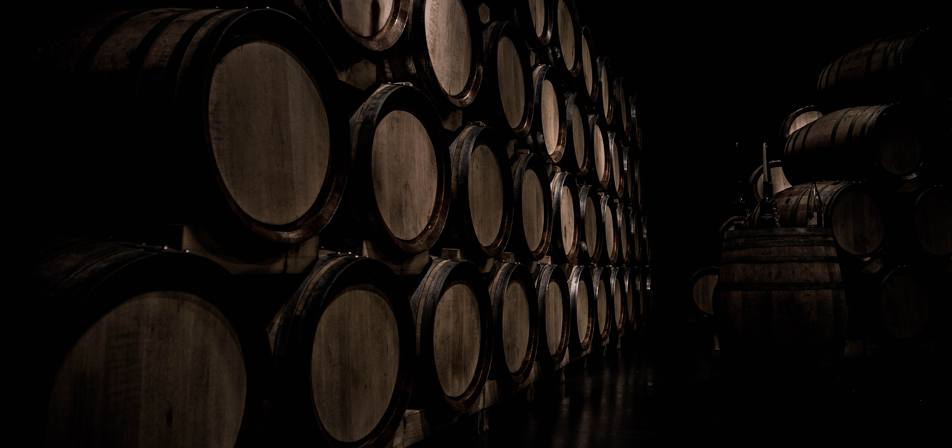
Modeling Capabilities of Digital Twin Platforms – Old Wine in New Bottles?
ECMFA@STAF ‘22
Jérôme Pfeiffer¹,
Daniel Lehner²,
Andreas Wortmann¹,
Manuel Wimmer²
1 Institute for Control Engineering of Machine Tools and Manufacturing Units, University of Stuttgart, Germany
2 CDL-MINT, Institute for Business Informatics - Software Engineering, Johannes Kepler University Linz, Austria
Photo by Daniel Vogel on Unsplash
Notes:
Hello everybody, and welcome to my talk at ECMFA 22
Name
research assistant at university of Stuttgart
Present the joint paper of my co-authors, Daniel Lehner, Manuel Wimmer from JKU Linz, and Andreas Wortmann and me from ISW of the university of Stuttgart.
Our paper has the title: …
Today
Want to shed light into the modeling capabilities of digital twin platforms.
We ask: Do they employ a novel way to model digital twins or do they reuse rather old concepts based on existing modeling standards just advertised as digital twin modeling languages?
For this:
1. take a look at the digital twin platforms
2. extract the metamodels of their languages
3. ask whether they align with existing concepts of modeling languages
4. how can we use these analysis results to enable platform portability

Slide 2
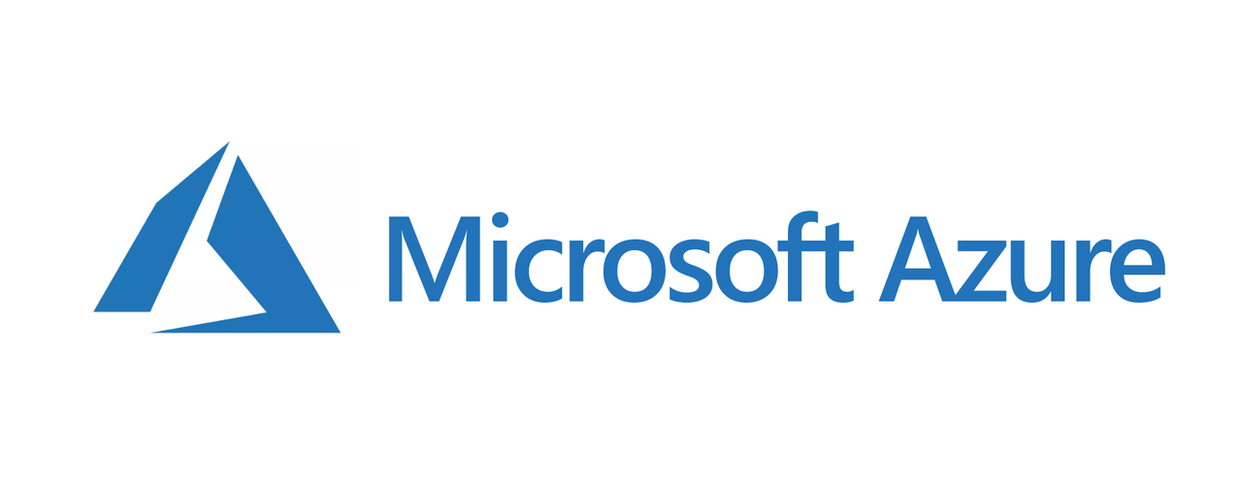

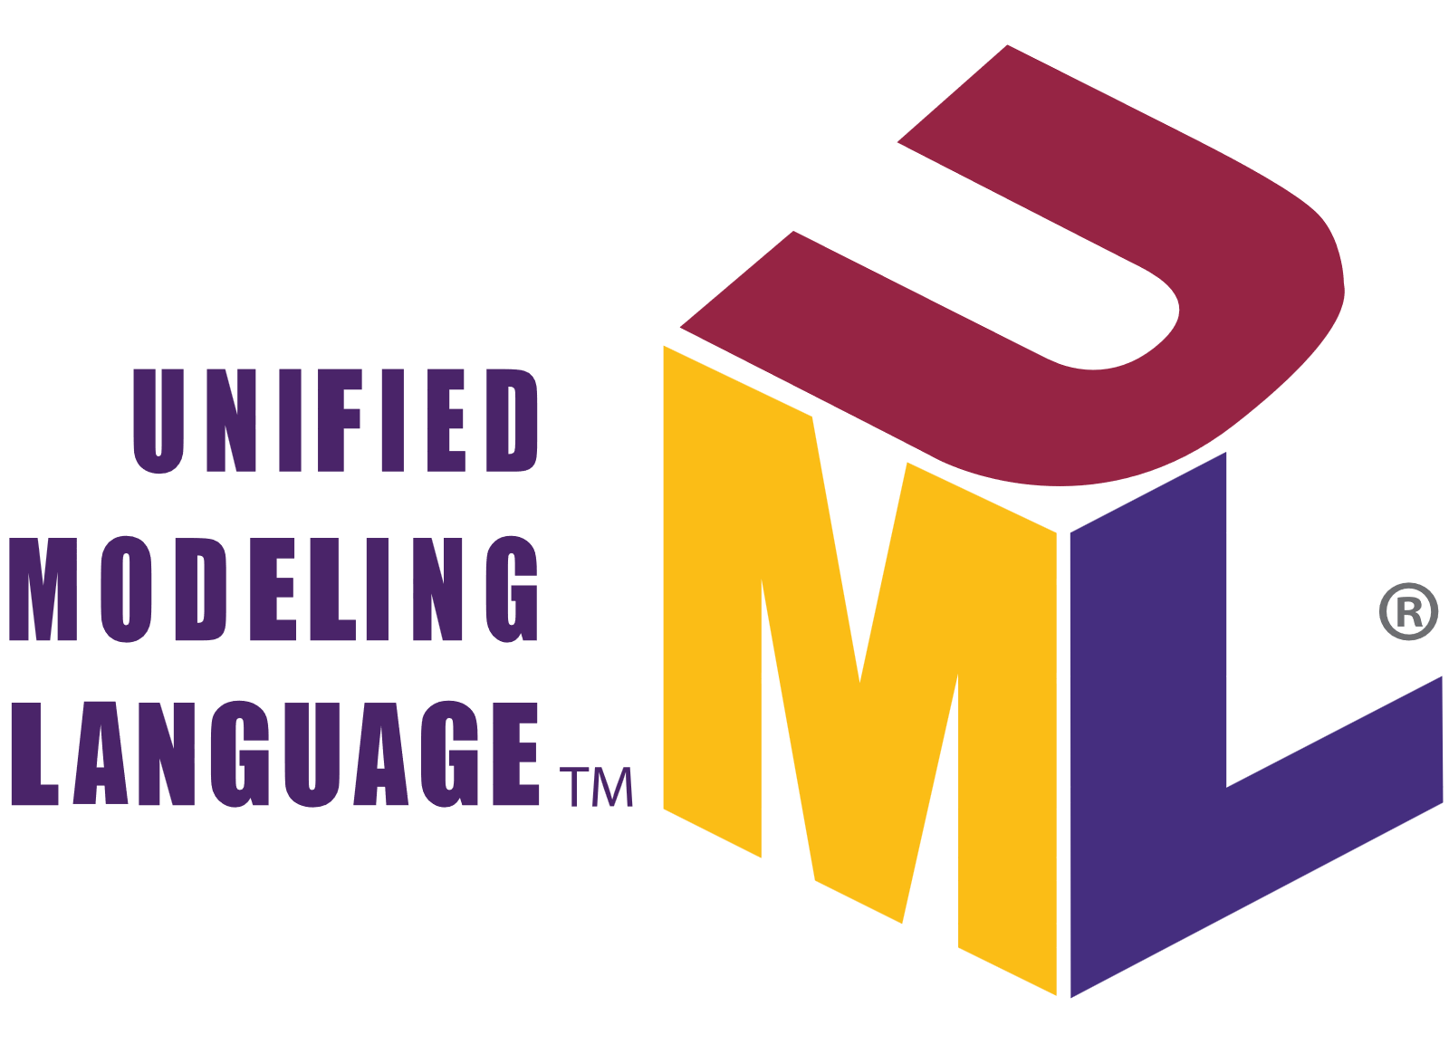

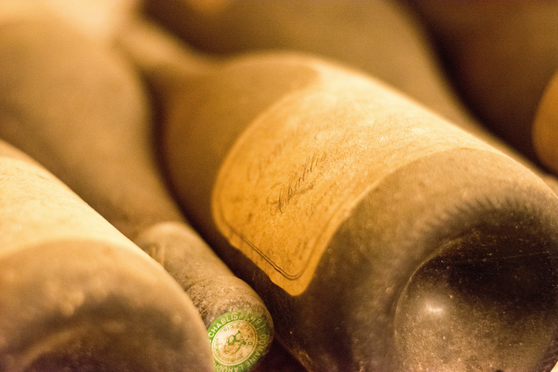

Digital Twin Platform Modeling Languages
A new hope for modeling digital twins?
Digital Twins (DTs) monitor and optimize cyber-physical systems
Developing DTs requires collaboration between software experts and CPS experts
DT Platforms provide dedicated modeling languages to facilitate DT engineering
New concepts? Or existing concepts (old wine) wrapped in new textual syntaxes (new bottles)?
Old wine in new bottles?
How to extend existing concepts?
Photo by Marco Mornati on Unsplash
Photo by Hermes Rivera on Unsplash
Notes:
Let’s start with the motivation of our research
Digital Twins (DTs) monitor and optimize cyber-physical systems (CPS)
Developing DTs requires collaboration between software experts and CPS experts which opens the famous conceptual gap between problem domain and solution domain
Modeling languages try to bridge the gap between CPS (domain) experts and software engineering experts
So called DT platforms provide dedicated modeling languages to facilitate DT engineering
Since one of our research focus is: How can we improve the way, digital twins are engineered via model driven techniques we were interested in these platform languages and wanted to find out whether:
These digital twin platforms provide concepts that innovate the way we engineer digital twins
Therefore, we looked at three digital twin platforms
MS Azure Digital Twins, AWS IoT TwinMaker, Eclipse Vorto
and investigated their modelling capabilities and analyzed whether they introduce completely new modelling techniques or rather existing and known techniques (old wine) but wrapped into new syntax and advertised as new (new bottles)
Furthermore, if they align with existing techniques, how can we employ existing techniques to model the platform specifics?

Slide 3
RQ1: What are the conceptual metamodels used by existing DT platforms? RQ2: How do the used metamodels relate to existing modeling concepts and standards? RQ3: How to extend UML class diagrams to support modeling concepts of DT platforms?
Research Questions
Notes:
This led us to the following research questions that build on top of each other
The first two are of analytical nature
The third one is a constructive proposal on how to use the DT platform languages for DT engineering

Slide 4
RQ1: What are the conceptual metamodels used by existing DT platforms?
Notes:
Lets start with answering RQ1: …
For each platform we first present their definition of the digital twin, and present the extracted metamodel afterward
To enable structured comparison of the DT languages provided by platforms we derive the conceptual metamodels
We did not take the concrete syntax into account since we aim for a pure conceptual comparison based on metamodels
We already got a glimpse on concrete syntax with the example models before
So: in the following: we present simplified metamodels of the languages provided by the platforms
→ full metamodel with all attributes, cardinalities etc. is depicted in paper

Slide 5

Microsoft Azure Digital Twin
A digital model of real-world things
Definition: A digital twin is a digital model of real-world things, places, business processes, and people
JSON-based Digital Twin Definition Language (DTDL)
Models
Contextualize raw data
Act as contract to other services
Queries for analysis on received data
Visualization
DTDL
1
2
3
4
5
6
7
8
9
10
11
12
13
14
15
16
17
18
19
{
"@id": "dtmi:com:example:Building;1",
"@type": "Interface",
"displayName": "Building",
"contents": [
{
"@type": "Property",
"name": "name",
"schema": "string",
"writable": true
},
{
"@type": "Relationship",
"name": "contains",
"target": "dtmi:com:example:Room;1"
}
],
"@context": "dtmi:dtdl:context;2"
}
https://azure.microsoft.com/en-us/services/digital-twins/
Notes:
Let’s start with the first digital twin platform: MS Azure Digital twin
Querying of data from Azure’s cloud and external services to perform analysis and computation on received data

Slide 6
RQ1: What are the conceptual metamodels used by existing DT platforms?
Uncovering the metamodel of Microsoft Azure DTDL
Extracted metamodel from GitHub¹
Structural description via
Interface: type of physical asset
Command: interaction with devices
Telemetry: continuous data streams
Property: not frequently changing
Relationship: association to interfaces
Component: composition of interfaces
DTMI
1
0..2 extends
Interface
DTElement
1 target
InterfaceContent
Command
Telemetry
Property
*
Relationship
Component
1
1
Schema
Object
Map
GeospacialSchema
InterfaceSchema
Array
Enum
PrimitiveSchema
¹https://github.com/Azure/opendigitaltwins-dtdl/blob/master/DTDL/v2/dtdlv2.md

Slide 7
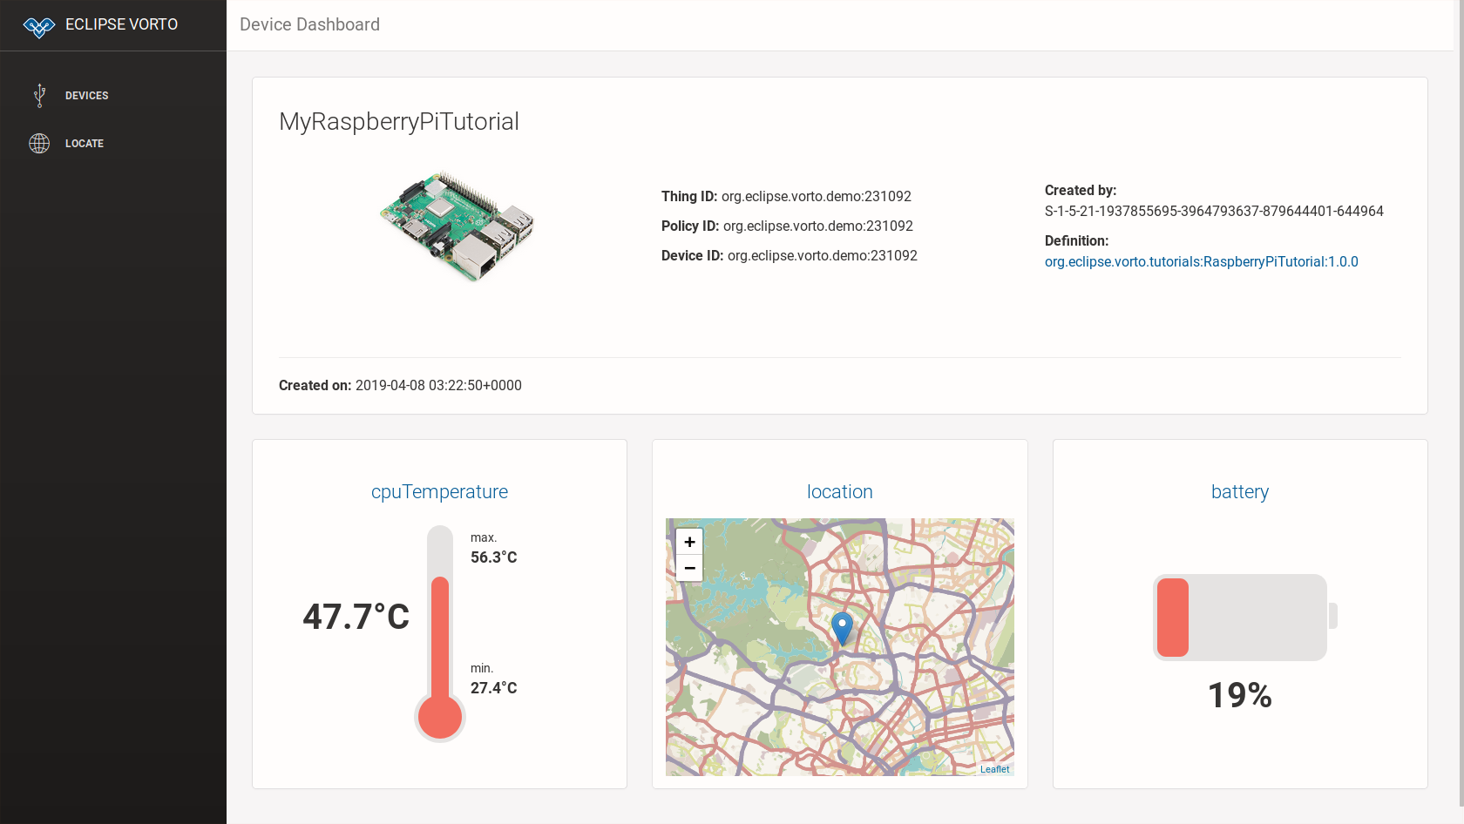

Eclipse Foundation
Digital Twins mirror the physical world
Definition: A digital twin
mirrors physical assets/devices
provides various aspects + services around devices
keeps real and digital world in sync
Modeling language: VortoLang
Code generators translate models into applications
VortoLang
1
2
3
4
5
6
infomodel Building{
functionblock {
room as Room
//…
}
}
1
2
3
4
5
6
functionblock Room {
status {
mandatory roomTemperature as Temperature }
}
https://github.com/eclipse/vorto/blob/master/docs/tutorials/create_webapp_dashboard.md
https://www.eclipse.org/vorto/

Slide 8
RQ1: What are the conceptual metamodels used by existing DT platforms?
Uncovering the metamodel of Eclipse VortoLang
Based on Ecore metamodel²
Describe asset structure via:
InformationModel: aggregates FunctionBlocks
FunctionBlock: reusable implementation parts
Event: a list of properties with timestamp
Operation: interaction with described asset
Property: attribute of function block
InformationModel
*
FunctionBlockProperty
superType
0..1
0..1 type
FunctionBlockModel
FunctionBlock
0..1 extended FunctionBlock
*
*
status *
* fault
* config
Event
Operation
Property
*
²https://github.com/eclipse/vorto/tree/development/core-bundles/meta-model.
Notes:
FunctionBlock: reusable implementation part that contain events, operations, or properties

Slide 9
AWS IoT TwinMaker
A dynamically updated digital representation of data
Definition:
A digital twin is a live digital representation
Dynamically updated with data to mimic the structure of the system
IoT TwinMaker is an AWS service
API to create digital twin models via JSON
Digital twin consist of components representing structural elements of the digital twin
Enables querying and visualization
AWS
1
2
3
4
5
6
7
8
9
10
11
12
13
14
15
16
{
"componentTypeId": "example.alarm",
"workspaceId": "MyWorkspace",
"isSingleton": false,
"propertyDefinitions": {
"alarm_status": {
"dataType": {
"type": "STRING"
"allowedValues": [
{"stringValue": "ACTIVE"
},//...
],
}, //...
}
}
}
https://docs.aws.amazon.com/iot-twinmaker/latest/guide/twinmaker-component-types-examples.html

Slide 10
RQ1: What are the conceptual metamodels used by existing DT platforms?
Uncovering the metamodel of AWS IoT TwinMaker
Extracted metamodel from API description³
Model data received from devices
ComponentType: defines a type of assets
Function: reference a function for interaction
PropertyDefinition: Defines properties
DataType: type of properties
Relationship: associations between types
[0..10] extendsFrom
ComponentType
*
Function
0..1 target
*
required Properties
nestedType
Property Definition
*
1
DataType
0..1
0..1
Relationship
³ https://docs.aws.amazon.com/iot-twinmaker/latest/guide/what-is-twinmaker.html
Notes:
Function: reference a function for interaction with the described assets
PropertyDefinition: Defines properties, i.e., attributes of the component

Slide 11
RQ1: What are the conceptual metamodels used by existing DT platforms?
Summary
Metamodels employ similar concepts for structural modelling, e.g., type and property definition
Difficulties: Imprecise or missing descriptions: e.g., faults in Eclipse VortoLang
Interesting restrictions:
Different upper bounds for inheritance from super-classes
Different inheritance depth limitations
Neither discussed nor rationales provided in platform documentation

Slide 12
RQ2: How do the concepts of platform languages relate to existing modeling concepts and standards?
Notes:
Given that all three investigated platforms pursue to describe data structures we now want compare these concepts to existing modeling techniques
→ To answer RQ2: .. .

Slide 13
RQ2: How do they relate to existing modeling concepts and standards?
Summary: A comparison with concepts of object-orientation
OOM Concepts (UML CD) | DTDL Metamodel | VortoLang Metamodel | AWS TwinMaker Metamodel
Class | Interface | FunctionBlock | ComponentType
Property | Property | Property | PropertyDefinition (isTimeSeries=true)
Temporal Property | Telemetry | Event | PropertyDefinition (isTimeSeries=false)
Association | Relationship | - | PropertyDefinition. DataType. Relationship
Method | Command | Operation | Function
Composition | Component | Function BlockProperty | -
Notes:
Class:
All metamodels support the concept class
But: marking a class as singleton is exclusive feature of AWS
All support the concept of extension/inheritance
Property:
All metamodels provide the concept of properties
DT platform languages support units, CD not
DTDL in addition enables defining a quantity (symbolic name for the unity, e.g., unit is degree in Celsius, the quantity is temperature)
Constraining values is possible via OCL or enums/sets of allowed values in all languages
Temporal: In UML CD time-series properties only possible via extension
Association:
Vortolang does not support associations
AWS cannot represent max and min multiplicity
Method:
All enable defining methods with parameters and return type like in UML
AWS can reference implementation within the AWS platform
Composition:
Not supported by AWS
High-level comparison shows most modeling concepts can also be found in common OOM like UML CD
But some concepts are restricted in the platform metamodels: e.g., cardinality of inheritance.
From IoT Background of platforms: Measurement Units for properties

Slide 14
RQ3: How to extend UML class diagrams to support modeling concepts of DT platforms?
Notes:
Discovered: most concepts found in platforms are available in UML CD but some are still not
Therefore: RQ3

Slide 15
RQ3: How to extend UML CD to support modeling concepts of DT platforms?
Using UML CD as a pivot language
UML
Using UML CD as a pivot
UML CD profile for digital twins (DTUML)
Stereotypes for platform-specific concepts
Add stereotypes to all CD metaclasses
Transform between n DT languages
Reduce transformations from n•(n-1) to 2•n
«metamodel»
ClassDiagram
Profile DTUML
extends
«Stereotype»
DTUML_Property
«Metaclass»
Property
trafo
trafo
trafo
Azure
AWS
Eclipse
«metamodel»
DTDL
«metamodel»
TwinMaker
«metamodel»
VortoLang
Notes:
Because of all the similarities between UML CD and the platform language metamodels
We use CD as a pivot
But because there are still differences in the details,
We add a UML profile to the UML CD metamodel with
Stereotypes for the platform specifics and assign them to the corresponding metaclasses of UML CD
Transform between platforms
realized with ATL on Ecore metamodels
Platform-specific translation into concrete platform models

Slide 16
RQ3: How to extend UML CD to support modeling concepts of DT platforms?
Extending UML CD to a digital twin variant of UML CD (DTUML)
Differentiate between
generic stereotypes for shared concepts
platform-specific stereotypes
Transformation from platform-specific model to DTUML without information loss
Limitations
Information loss between platforms
Default values or derivation rules
Extend profile for new platforms
Profile DTUML
«Stereotype»
DTProperty
«Metaclass»
Property
Boolean isTimeSeries
String unit
String type
Class type
Int lower
Int upper
Boolean readOnly
Property redefinedProperty
Value defaultValue
«Stereotype»
VortoLang_Property
«Stereotype»
DTDL_Property
«Stereotype»
AWS_Property
Boolean isFault
String constraintRule
String quantity
Boolean isExternalId
Boolean isStoredLocally
List<String> allowedValues
Notes:
Let’s take a look at a concrete profile of DTUML for properties

Slide 17
RQ3: How to extend UML CD to support modeling concepts of DT platforms?
Applying the DTUML Profile to a demonstration case (for DTDL and TM)
«AWSClass»
{isSingleton = true} Building
*
Robot
«DTDLClass» {displayName = „Temperature Sensor“} TemperatureSensor
*
String type
String value «DTProperty» {
isTimeSeries = true
unit = „degreeFahrenheit“}, «DTDLProperty»{
quantity = „Temperature“}
*
1
*
Room
Controller
int aqLevel «DTProperty» { isTimeSeries = true }
1
«DTDLClass»
{displayName = „ CO₂ Sensor“}
CO2Sensor
Alarm
*
*
Boolean isActive
String type
String value «DTProperty» {
isTimeSeries = true
unit = „ppm“ }
«DTDLClass»
{displayName = „Ventilation System“}
VentilationSystem
Notes:
Next we take a look at a concrete class diagram annotated with stereotypes of our profile DTUML
The CD represents a scenario where:
Robots equipped with controller and attached temperature and CO2 sensor drives around rooms and can give an alert whenever a certain threshold is passed.
Rooms can then activate their ventilation system to improve air quality
One could use this model to transform from DTDL -> DTUML -> TM
But: loose of information that is specific to platforms and not applicable
isSingleton not applicable in DTDL
DTDL quantity or displayName are not applicable to TM

Slide 18
Old wine in new bottles?
Notes:
So, finally we can answer the question: are these modeling capabilities of the DT platforms just New or just “Old wine in new bottles?”

Slide 19
Summary
Old Wine in New Bottles?
RQ1: What are the conceptual metamodels used by existing DT platforms?
The extracted metamodels share similar modeling concepts
But: Many aspects not covered by platform languages, e.g., behavior, communication, performance
RQ2: How do the used metamodels relate to existing modeling concepts and standards?
Concepts of the platforms align with object-oriented concepts and UML CD
Extend them with domain-specific concepts, e.g., units, time-series
RQ3: How to extend UML class diagrams to support modeling concepts of DT platforms?
Using UML CD as a pivot, together with an UML profile enables modelling platform specifics
Outlook:
Explore other DT platforms and derive a pivot DT DSL for their platform independent description
Design a language family (product line) for describing further aspects of digital twins
Notes:
Unfortunately, and as you all might know now: the answer is yes, they are just pured old wine in new bottles
But lets take a look at the answers to our research questions again:
RQ1:
More specific they wrap CD-like data structure description languages into a modern UI and label them as DT DSLs
Outlook:
Modeling and Analysis of Real Time Embedded Systems (MARTE)
language family including code generation specific to DT platforms

Slide 20

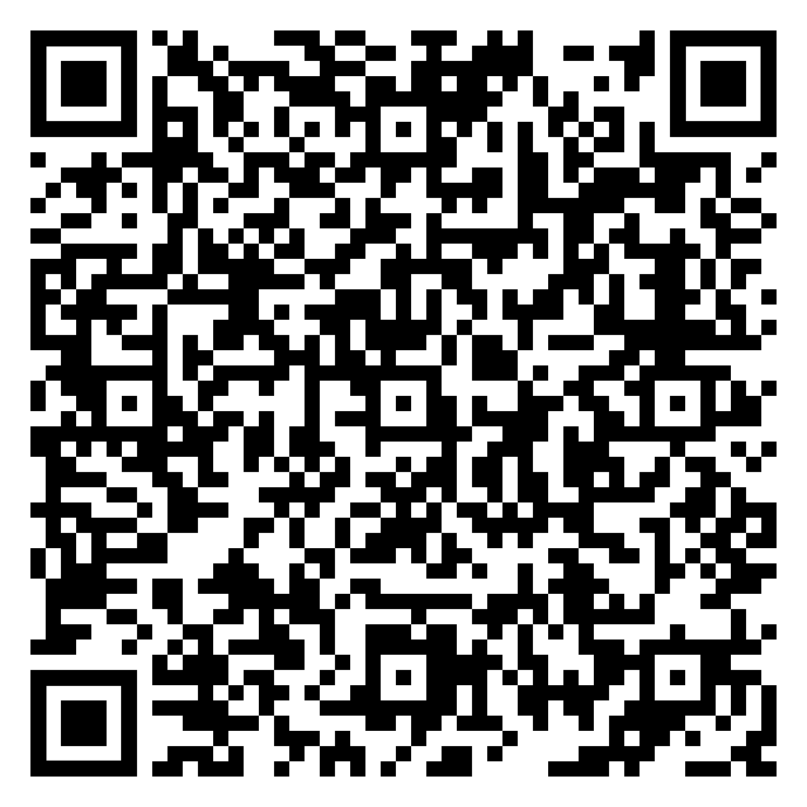
Jérôme Pfeiffer
Research Assistant
jerome.pfeiffer@isw.uni-stuttgart.de
94500
linkedin.com/in/jerome-pfeiffer/
scan for full paper
Notes:
Thank you all for your attention
Now open to any questions you have

